Slide 1

THE THEKKA
Here for your taste
Submitted by
NIKHIL RAWAL– 1810992061
SHIVAM BANSAL- 1810992032
Submitted to
MS PREETI SAINI

Slide 2
Introduction
This Is An Era Of Technology And The Technology Is So Fast That Anyone Can Do Anything In A Click. The Internet Is The Way That Helps A Person In All Aspects.
People Tend To Google Around The Best And The Affordable Stores Around The City Before Going For Shopping.
THE THEKKA Established In 1989, and Is A Trendsetter In Supplying The beverages At The Most Competitive Prices.

Slide 3

About The Store
THE THEKKA Is A bar Located In Sector
22-A In The City Beautiful Chandigarh.

Slide 4

Aims And Objectives
Increase Sales.
Become An Authoritative Resource And Providing Quality Content On Our Website, Regularly Adding New Information, Establishing Trust, Marketing Ourr Site On Other Websites And Social Media.
Improve Interaction With Existing And Potential Customers.

Slide 5




Technology Used
Hardware :
Intel(R) Core ™ i5-5200U CPU @ 2.20 GHz with 4.00 GB RAM
Operating System :
64 - Bit Windows
Software :
Windows10
Notepad/Sublime text

Slide 6


Designing And Scripting Language
Html5
Css3
Javascript
Browser
Google Chrome(64-BIT)

Slide 7
Features
Features Of Css
Easier to maintain and update
Greater consistency in design
More formatting options
Lightweight code
Ease of presenting different styles to different viewer
Greater accessibility
Features Of Javascript
Javascript is executed on the client side.
Javascript is a relatively easy language.
Javascript is relatively fast to the end user.
Extended functionality to web pages.

Slide 8

Limitations
Only front-end technologies like javascript, css and html is used.
Back-end technologies like php, asp.Net, and databse like ACCESS and mysql could be incorporated.
It could be made to accept online orders.
Online payment feature can also be added.

Slide 9
Screen Layouts

Slide 10

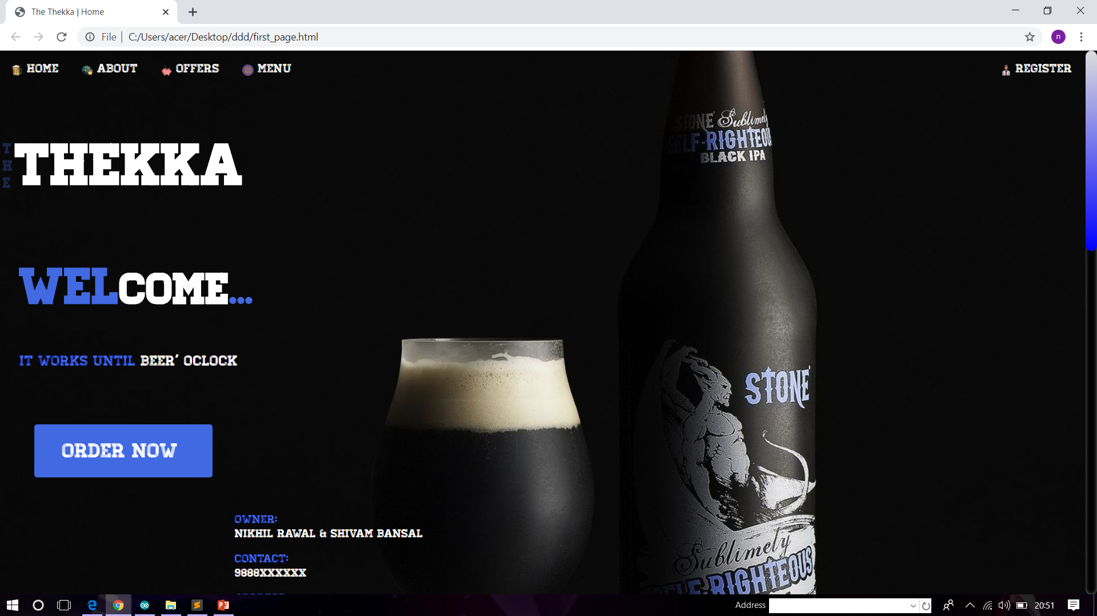
Home

Slide 11

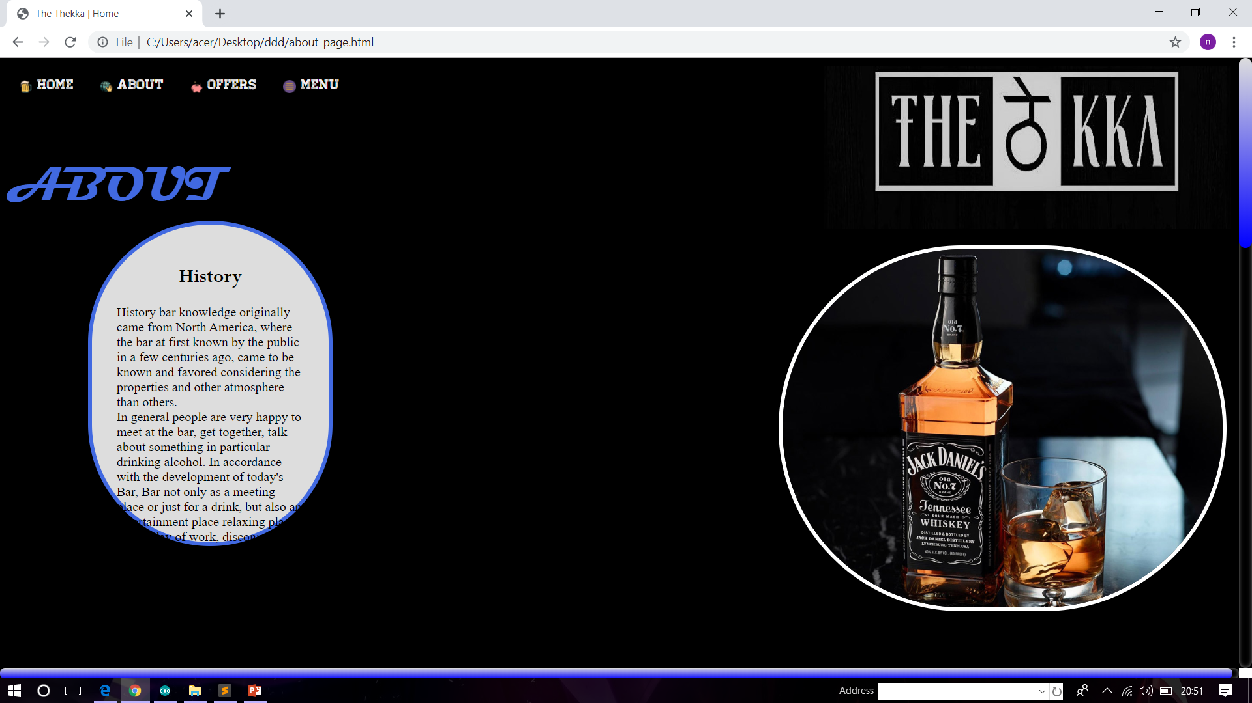
About Us

Slide 12
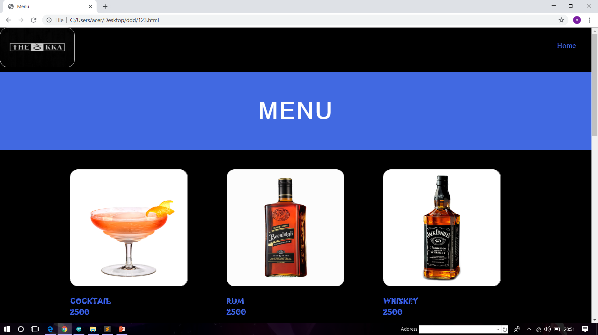
MENU

Slide 13
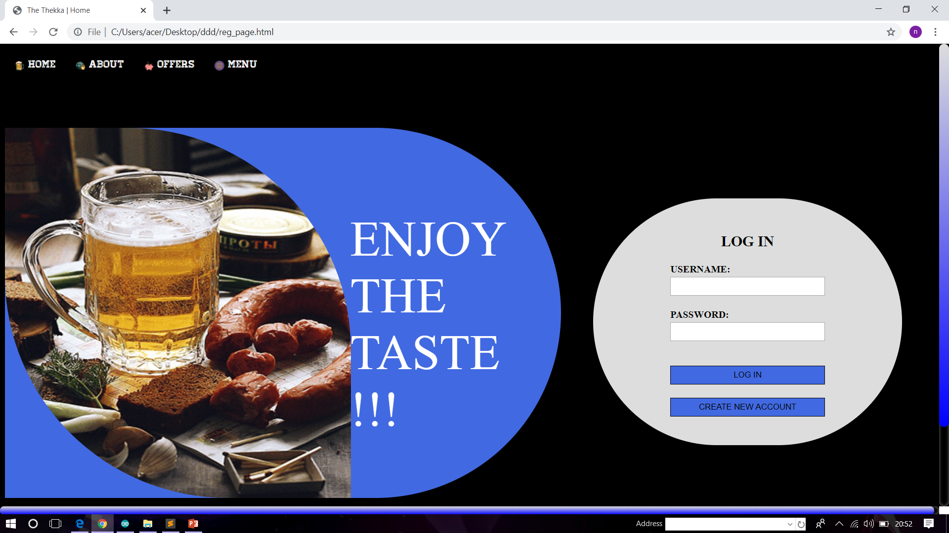
REGISTRATION

Slide 14
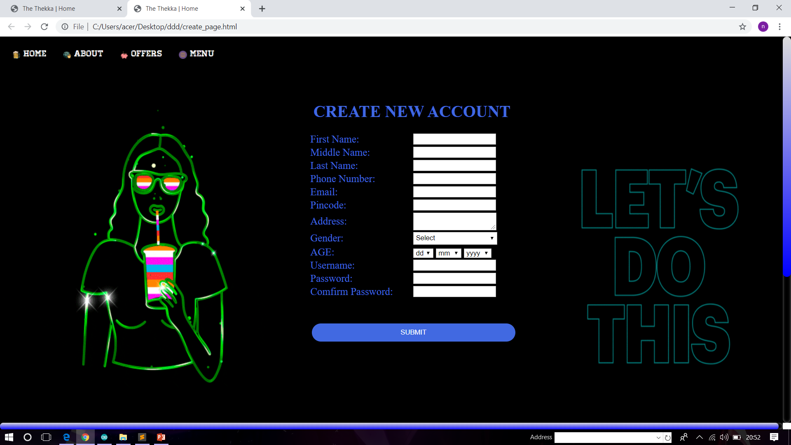
CREATE ACCOUNT

Slide 15
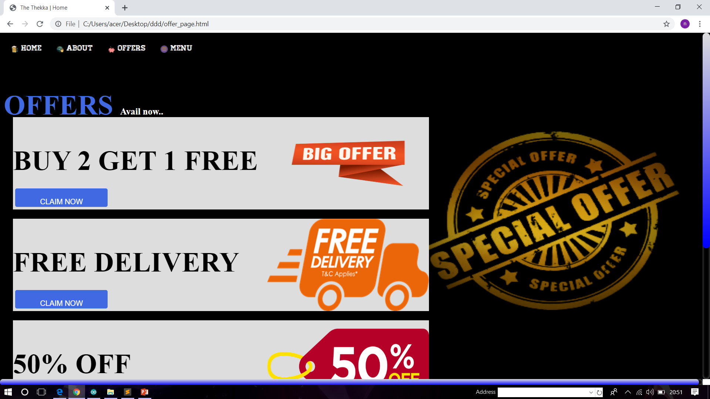
OFFERS

Slide 16
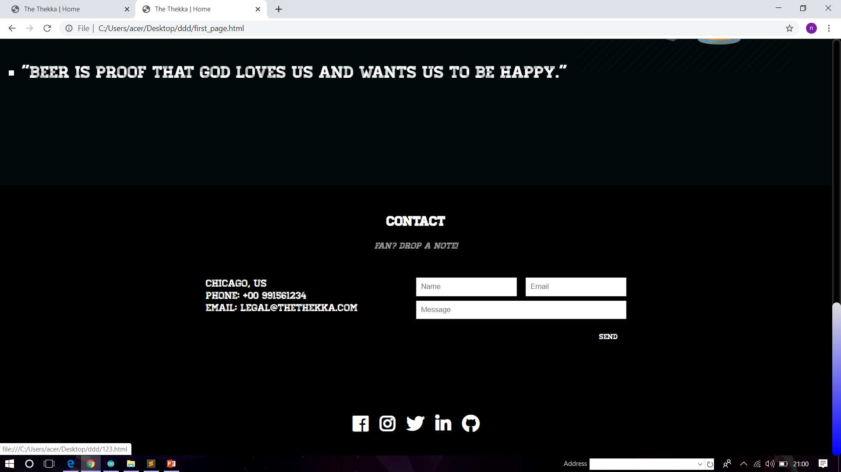
CONTACT US

Slide 17

THANKYOU

